Slide 1

San Francisco Crime Categorization
Utilizing SFPD historic data and data science technology in achieving high level of efficiency in deployment of workforces as proactive measure to address the crime in San Francisco Bay area.
By
Harshida Jegadeesh Chandar

Slide 2
Introduction
San Francisco, like all metropolitan cities is hot bed for thriving criminal activities. The San Francisco Police Department (SFPD) is constantly challenged in allocating workforce in prevention of crime to be proactive than reactive. With the current data science technology SFPD would like to better understand crime distribution and category and enable them to anticipate the current and future occurrence of crime

Slide 3

Project Scope
Derive information from the last 12 years of data provided by SFPD.
Analyse distribution and category of crime in San Francisco Bay area.
Build a classification model which can classify a crime occurred based on datetime and location.

Slide 4


Project Goal
Build three different multiclass classification models
Parameter tuning to achieve high accuracy with low log loss
Base for building future AI model

Slide 5




Project Flow
Exploratory Data Analysis
Understand & Visualize Data; Analyse & Pre-process Data; Establishing Data Dimensions
Feature Engineering
Feature Transformation; Derived Features; Feature Interaction
Modelling
Naïve Bayes Classifier, Random Forest & KNN
Model Selection
Summarize Models and select based on Low Loss log (Entropy) and High Accuracy

Slide 6


Data Description-Train & Test
389,257
Dates
39
Category
Descript
Provides the date and time stamp of crime incident.
Identifies type of crime as classified by SFPD. It’s the target feature-39
Provides brief elucidation for the Crime
7
10
Pd District
Resolution
Day of Week
List the Police department district names.
How the crime was resolved in the past.
The Day of the week when the crime occurred.
23,228
Address
39000
X, Y
Approximate address of where the crime occurred
Spatial coordinates of the place of crime

Slide 7
Data cleansing
2323 duplicate records, to the extent they even match datetime stamp and location coordinates as well. These records were removed.
There are 67 records with completely wrong geo coordinates for it to belong in City of San Francisco.
5 records were updated with the correct coordinates based on their address matched
62 records were removed, because we do not have the matching addresses.

Slide 8
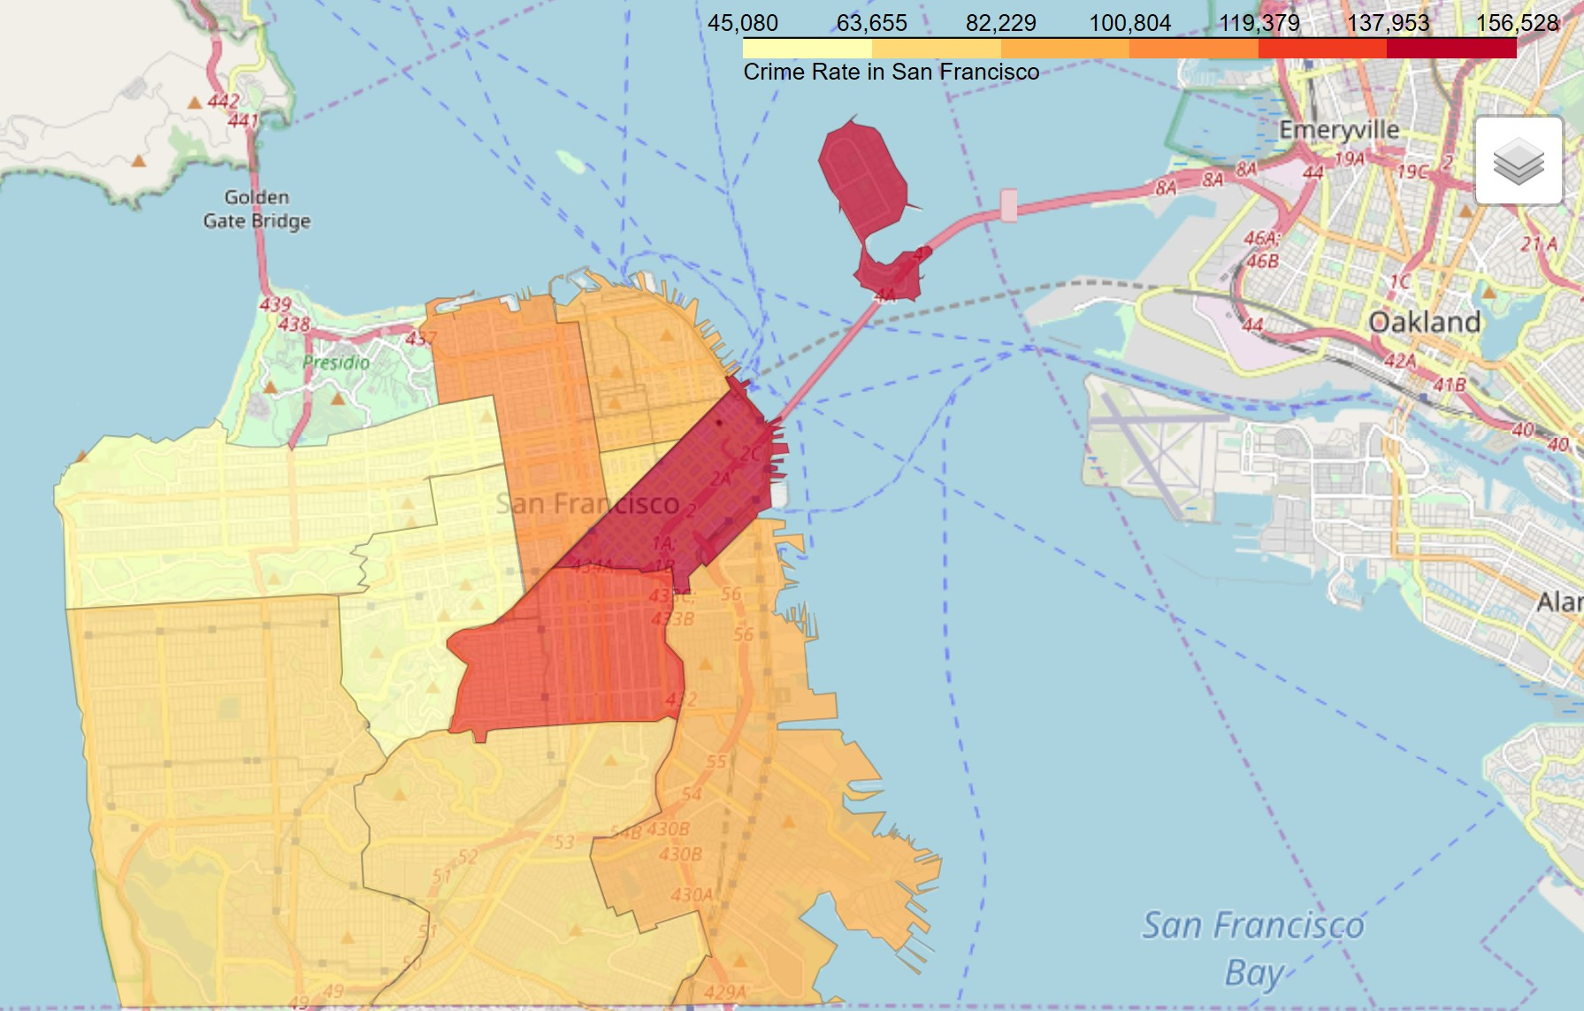
Crime Intensity in SF Districts
Northern
central
Richmond
Southern
Park
Mission
Taraval
Ingleside
Bayview

Slide 9
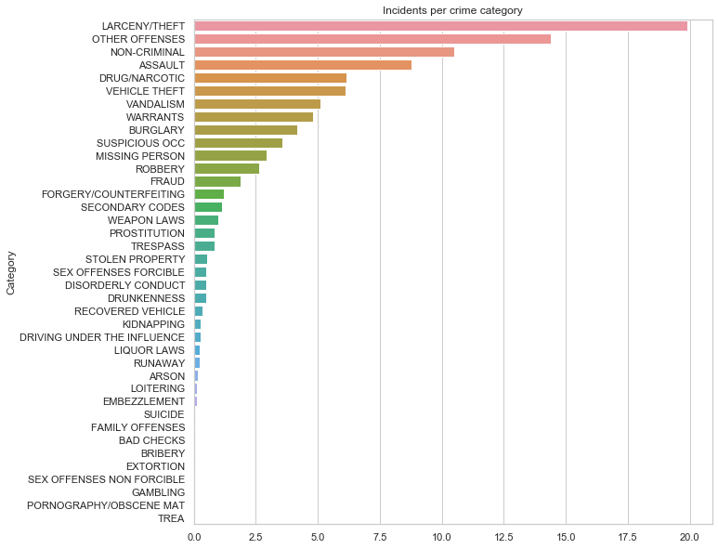
Crime Category

Slide 10
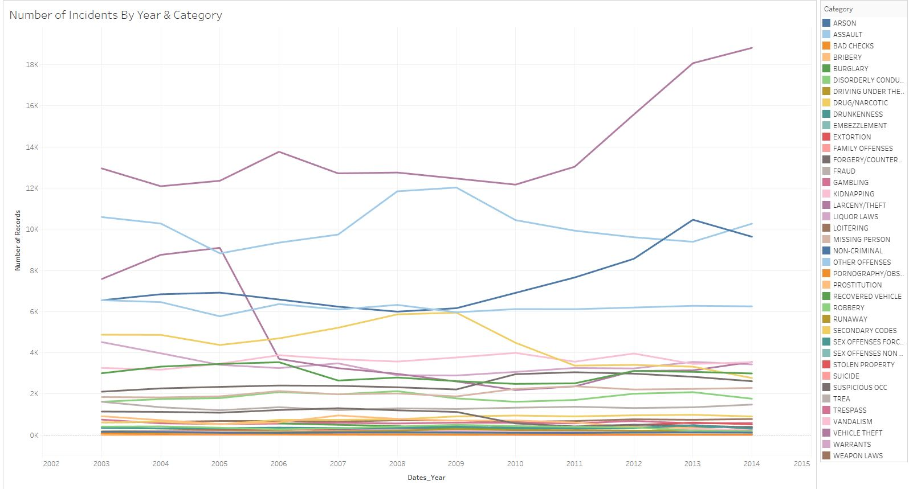
Crime Category Trends

Slide 11
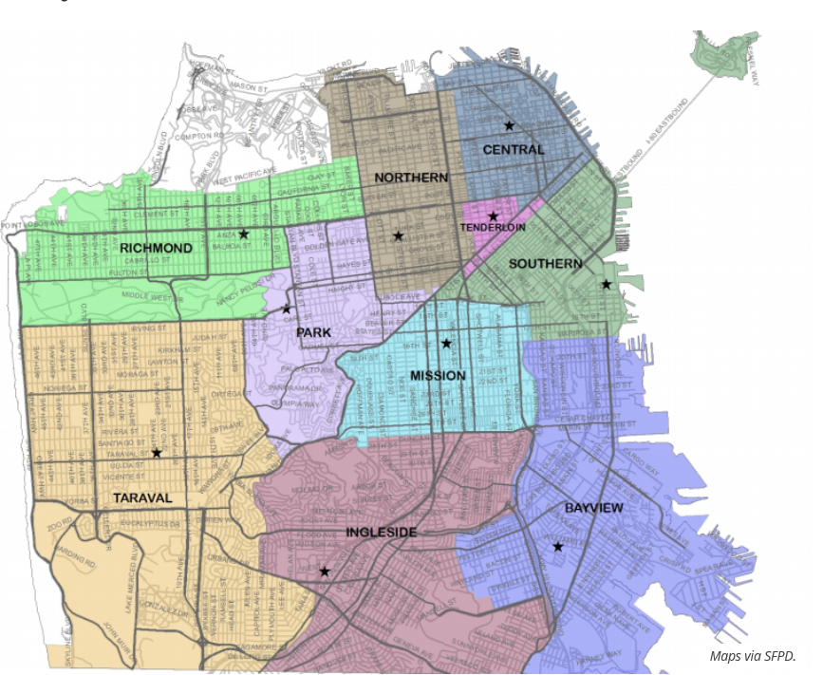
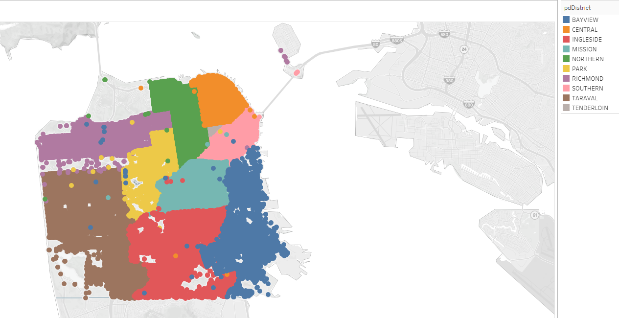
SFPD Districts Boundaries
Official SFPD district boundaries map
boundaries as per the Location Data

Slide 12

Feature Engineering
Location Dimension
Unique combination of Address, X and Y
Address
X (Longitude)
Y (Latitude)
Pd District boundaries
New Table CrimeAddress
AddressID
Address
AddressID
Crime Incidents table
X (Longitude)
Y (Latittude)
Minimal engineering required to build the classification model

Slide 13

Feature Engineering
Time Dimension
Dates
Dates
Derived data
Dates_Year
Numerical representation of Time
Crime Incidents table
Dates_Month
Dates_Day
Dates_Hour
Dates_Minutes
Dates_Seconds
Dates_WeekOfYear
Dates_DayOfYear
DayOfWeek
Minimal engineering required to build the classification model

Slide 14

Feature Engineering
Time and Category Dimensions
Aggregated by Category and Time Measure
Category
New Engineered Features
WeekOfYear_Category
Time and Category statistical information at record level
Crime Incidents table
WeekOfYear
DayOfYear
DayOfWeek
MonthOfYear
DayOfMonth
HourOfDay
DayOfYear_Category
DayOfWeek_Category
HourOfDay_Category
MonthOfYear_Category
DayOfMonth_Category
Elaborate engineering to aid classification model

Slide 15
Feature Engineering
Time , Category and Location Dimensions
Aggregated by Category and Time Measure
Category
New Engineered Features
WeekOfYear_Category_Address
Time, Category and Location statistical information at record level
Crime Incidents table
WeekOfYear
DayOfYear
DayOfWeek
MonthOfYear
DayOfMonth
HourOfDay
AddressID
DayOfYear_Category_Address
DayOfWeek_Category_Address
MonthOfYear_Category_Address
DayOfMonth_Category_Address
HourOfDay_Category_Address
Elaborate engineering to aid classification model

Slide 16



Classification Models
Assumes that a feature in a class is independent of the other features. Thus called Naïve
K nearest neighbors is an algorithm that stores all available cases and classifies new cases based on a similarity measure
Creates decision trees on random data samples, obtains prediction from each and identifies best through voting

Slide 17
Modelling
Category
DayOfWeek
PdDistrict
X
Y
n_days
Day
Month
Year
Hour
Minute
Block
5.449 sec
16.33 sec
879.28 sec
Time
0.1953
0.1781
0.3169
Accuracy
2.624
18.69
4.83
Log Loss

Slide 18
Modelling
Dates_Year
Dates_Month
Dates_Day
Dates_Hour
Dates_Minutes
Dates_Seconds
Dates_WeekOfYear
Dates_DayOfYear
Category
DayOfWeek
PdDistrict
X
Y
AddressID
WeekOfYear_Category
DayOfYear_Category
DayOfWeek_Category
HourOfDay_Category
DayOfMonth_Category
MonthOfYear_Category
WeekOfYear_Category_Address
DayOfYear_Category_Address
DayOfWeek_Category_Address
HourOfDay_Category_Address
DayOfMonth_Category_Address
MonthOfYear_Category_Address
341.07 sec
5.047 sec
879.28 sec
0.98
0.42
0.64
0.42
0.154
3.547
4.086

Slide 19


Recommendations
We highly recommend that the incident management system requires a full integration with City of San Francisco GIS system
We recommend that “Other Offenses” category needs to be evaluated and defined more granularly for better understanding of the offense.
Investigate the data collection and/or ETL processes. If required introduce a unique ID to each incident record.
Implement Business Intelligent for visualizing data in different dimensions and measures.

Slide 20

Thank you
Any Questions…..?

